Slide 1
CSC 101 Applied Physics Spring 2023
Chapter-5 Equilibrium of a Rigid Body

Slide 2
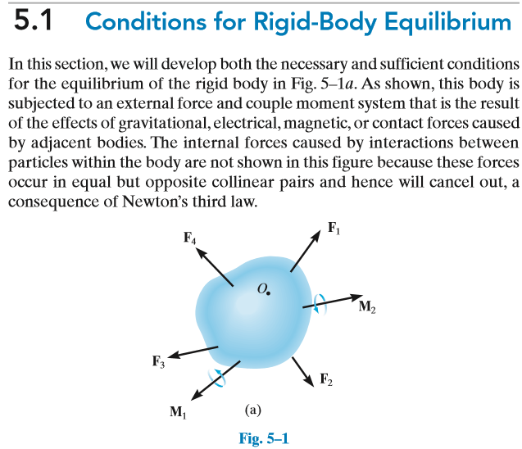
Chapter-4 Equilibrium of a Rigid Body
5.1 Conditions for Rigid Body Equilibrium

Slide 3
Chapter-4 Equilibrium of a Rigid Body
5.1 Conditions for Rigid Body Equilibrium
Conditions for Equilibrium:
In our previous chapter 3, we had studied Equilibrium and saw some conditions of equilibrium
So based on that previous knowledge, we can say that the resultant or the sum of all the forces that are acting externally is zero
Similarly, we can say, that sum of all the forces or resultant of all the forces that are acting internally is also zero

Slide 4
Chapter-4 Equilibrium of a Rigid Body
5.1 Conditions for Rigid Body Equilibrium
Conditions for Equilibrium:
Similarly, based on our previous knowledge, we can say that, sum of all the moments that are observed on the object is also zero
Hence, we can say that the object is in equilibrium since::
sum of all the forces that are acting externally is zero
sum of all forces acting internally is also zero
sum of all the moments is also zero

Slide 5
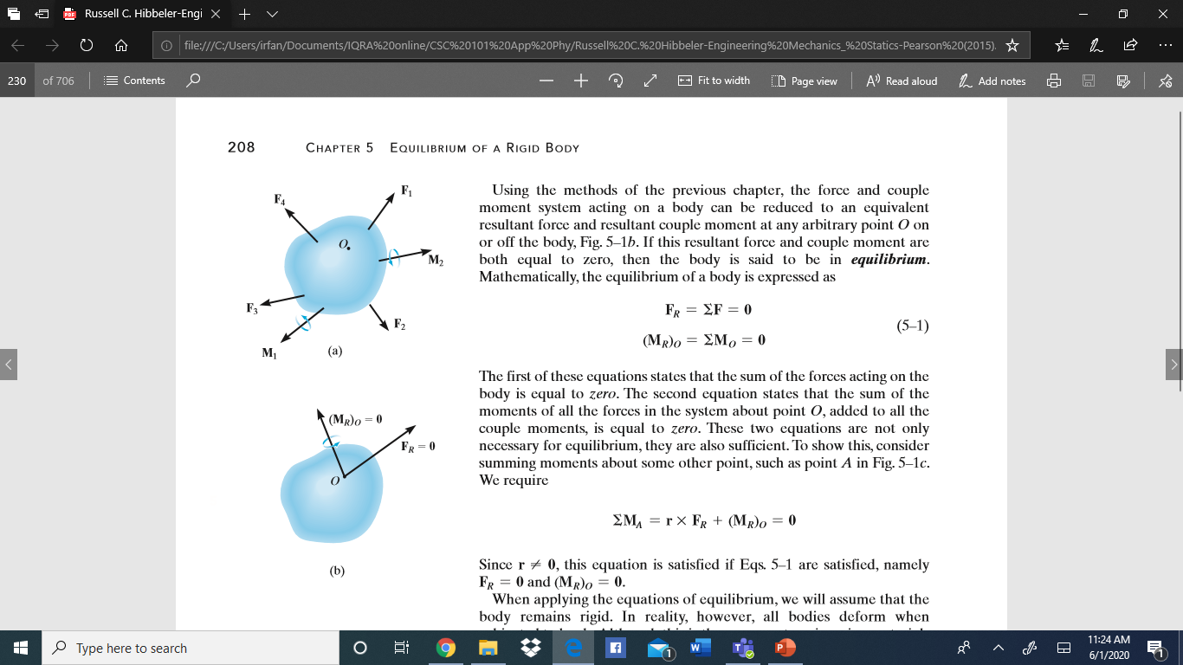
Chapter-4 Equilibrium of a Rigid Body
5.1 Conditions for Rigid Body Equilibrium

Slide 6
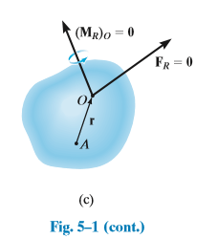
Chapter-4 Equilibrium of a Rigid Body
5.1 Conditions for Rigid Body Equilibrium

Slide 7
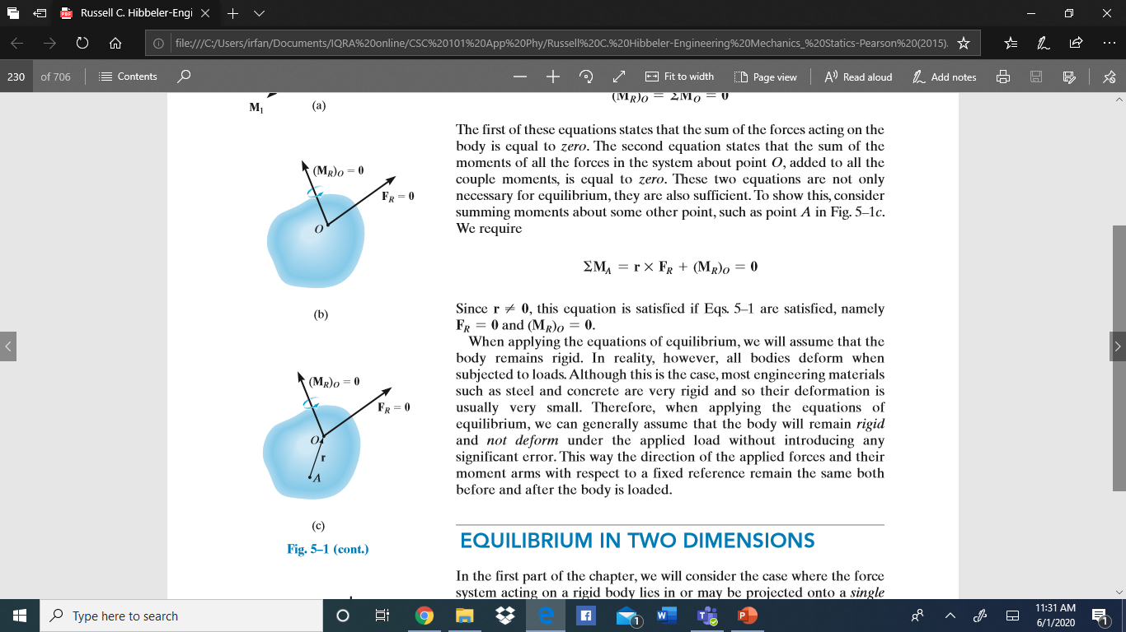
Chapter-4 Equilibrium of a Rigid Body
5.1 Conditions for Rigid Body Equilibrium
We should note that:
When applying the equations of equilibrium, we will assume
that the body remains rigid
In reality, however, all bodies deform when subjected to
loads.
Although this is the case, most engineering materials such
as steel and concrete are very rigid and so their deformation is usually very small.

Slide 8
Chapter-4 Equilibrium of a Rigid Body
5.1 Conditions for Rigid Body Equilibrium
We should also note that:
Therefore, when applying the equations of equilibrium, we can generally assume that the body will remain rigid and not deform under the applied load without introducing any significant error.
This way the direction of the applied forces and their moment arms with respect to a fixed reference remain the same both before and after the body is loaded.

Slide 9
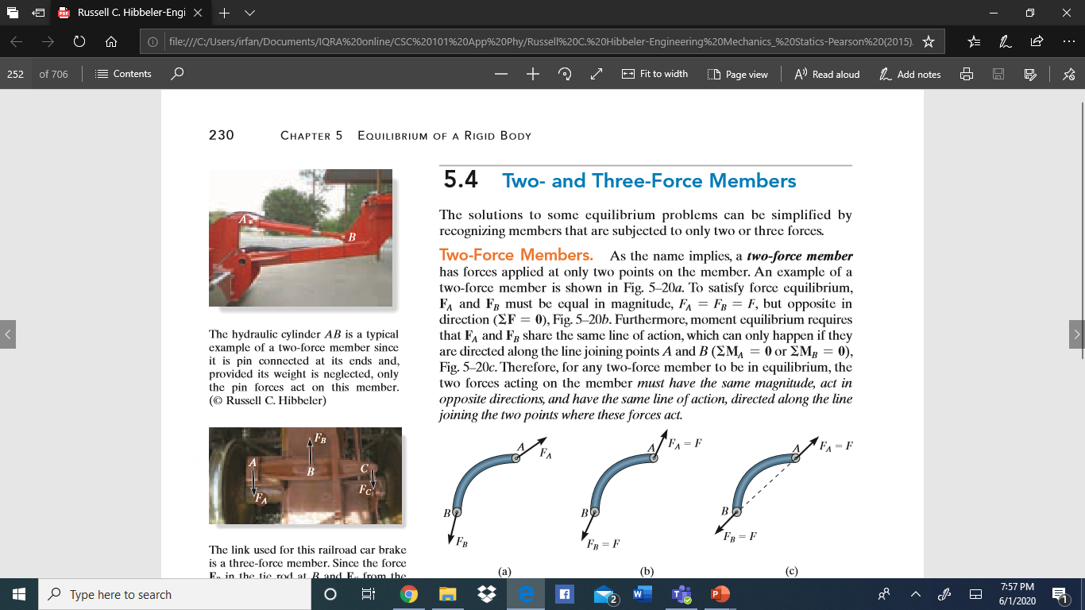
Chapter-4 Equilibrium of a Rigid Body
5.4 Two and Three Force-members
Two Force Members:
As the name implies, a two-force member has forces applied at only two points on the member
An example of a two-force member is shown in Fig. 5–20a.
To satisfy force equilibrium, FA and FB must be equal in magnitude, FA = FB = F, but opposite in direction (ΣF = 0), Fig. 5–20b.

Slide 10
Chapter-4 Equilibrium of a Rigid Body
5.4 Two and Three Force-members
Two Force Members:
As the name implies, a two-force member has forces applied at only two points on the member
Furthermore, moment equilibrium requires that FA and FB share the same line of action, which can only happen if they are directed along the line joining points A and B (ΣMA = 0 or ΣMB = 0), Fig. 5–20c.

Slide 11
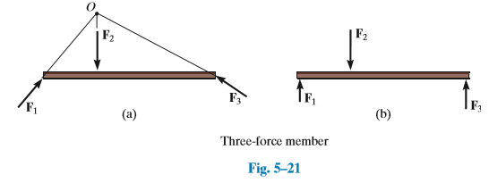
Chapter-4 Equilibrium of a Rigid Body
5.4 Two and Three Force-members
Three Force Members:
If a member is subjected to only three forces, it is called a three-force member
Moment equilibrium can be satisfied only if the three forces form a concurrent or parallel force system.
To illustrate, consider the member subjected to the three forces F1, F2, and F3, shown in Fig. 5–21a.

Slide 12
Chapter-4 Equilibrium of a Rigid Body
5.4 Two and Three Force-members
Three Force Members:
If a member is subjected to only three forces, it is called a three-force member
If the lines of action of F1 and F2 intersect at point O, then the line of action of F3 must also pass through point O so that the forces satisfy ΣMO = 0.
As a special case, if the three forces are all parallel, Fig. 5–21b, the location of the point of intersection, O, will approach infinity.

Slide 13

Chapter-4 Equilibrium of a Rigid Body
5.4 Two and Three Force-members

Slide 14

Chapter-4 Equilibrium of a Rigid Body
5.4 Two and Three Force-members

